Slide 1


Nazim
31st May 2023

Slide 2

Outline
Executive Summary
Introduction
Methodology
Results
Conclusion
Appendix

Slide 3
Executive Summary
Summary of Methodologies:
This project follows these steps:
Data Collection
Data Wrangling
Exploratory Data Analysis
Using Relational Database and CSV Files
Interactive Visual Analytics
Dashboards
Predictive Analysis (Classification)
Using Panda Libraries extensively
Summary of Results:
This project produced the following outputs and visualizations:
Exploratory Data Analysis (EDA) results
Geospatial analytics
Interactive dashboard
Predictive analysis of classification models

Slide 4
Introduction
Project background and context
One of the major issue in Space launches has been the cost of a launch , Space X has shown that the cost can be considerably reduced . Space X launches at the cost of 62m vs the competitors cost of 162m. Much of the savings are achieved by SpaceX as it can land, and then re-use the first stage of the rocket.
Problems you want to find answers
Critical information we need to find out is how can we re-use the first stage , we need to identify the causes of the failures and the success factor. So that we can use this information for our company Space Y to successfully use first stage and cut cost and be competitive with Space X

Slide 5

Section 1

Slide 6
Methodology
Data Collection
Collection data from spacexdata.com
Web Scraping from List of Falcon 9 and Falcon Heavy launches (2010–2019) - Wikipedia
Data Wrangling
Scrubbing , Organizing the data into proper columns removing blank data and filling it with mean values.
Hot encoding
Exploratory Data Analysis
Using SQL queries to manipulate and evaluate the SpaceX dataset
Using Pandas and Matplotlib to visualize relationships between variables, and determine patterns
Interactive Visual Analytics
Geospatial analytics using Folium
Creating an interactive dashboard using Plotly Dash
Data Modelling and Evaluation
Using Panda libraries to:
Pre-process (standardize) the data
Split , test and data using train_test_split
Usingdifferent classification models
Find hyperparameters using GridSearchCV
Plotting confusion matrices
Assessing the accuracy of each classification model

Slide 7
Data Collection
Data was collected from spacexdata.com and List of Falcon 9 and Falcon Heavy launches (2010–2019) - Wikipedia
Spacexdata collected through API contains the historical data of the launches with information pertaining to site of the launch, payload, launch specification, its landing outcome and other details
Used
GET response
Stored in Dataframes
Used Sql and Data Manipulation Language
Focus on Falcon 9 launches

Slide 8
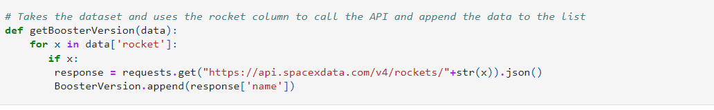
Data Collection – SpaceX API
Import Launch Data using GET method from Spacex
Space X provides its launch data on its website
Normalize data and place it in Dataframe
IBMCertProject/01.data-collection-api.ipynb at main · inazim/IBMCertProject (github.com)
Scrub and organize the data for missing values and other details
Filter Falcon 9 Data

Slide 9
Data Collection - Wrangling
Data Analysis
Started with Data Analysis
Calculated the Summary values
# of Launches on Eachsite
# of Occurrences on Each Orbit
Calculated # of occurrences of mission outcome per orbit
Hot encoding the Landing outcome
Summarizations
Hot Encoding of Landing Outcome
IBMCertProject/02.data_wrangling_jupyterlite.jupyterlite.ipynb at main · inazim/IBMCertProject (github.com)
9

Slide 10
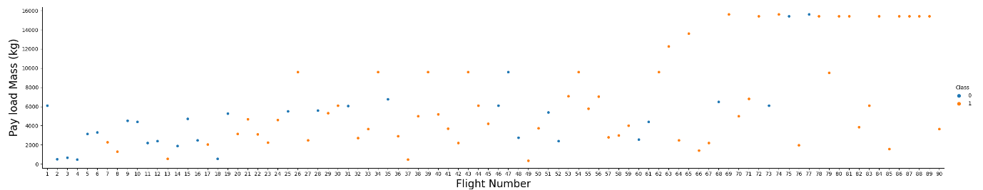
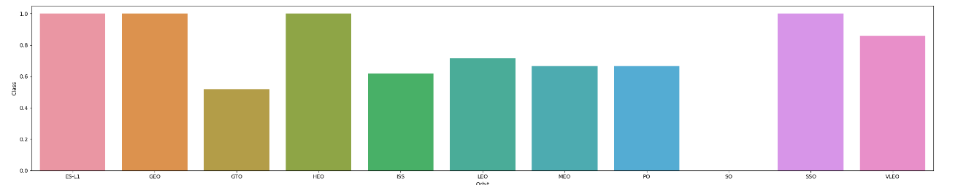
EDA with Data Visualization
Data was visualized using Scatter Charts, Line Charts and Bar Charts
Next slide please for the URL

Slide 11
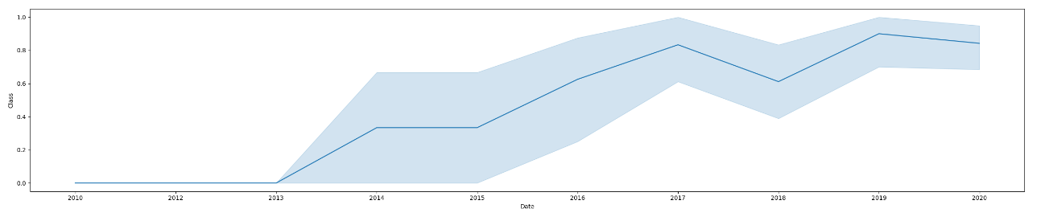
EDA with Data Visualization
Data was visualized using Scatter Charts, Line Charts and Bar Charts
IBMCertProject/04.eda-dataviz.ipynb.jupyterlite.ipynb at main · inazim/IBMCertProject (github.com)

Slide 12
EDA with SQL
The SQL queries performed on the data set were used to:
Display the names of the unique launch sites in the space mission
Display 5 records where launch sites begin with the string ‘CCA’
Display the total payload mass carried by boosters launched by NASA (CRS)
Display the average payload mass carried by booster version F9 v1.1
List the date when the first successful landing outcome on a ground pad was achieved
List the names of the boosters which had success on a drone ship and a payload mass between 4000 and 6000 kg
List the total number of successful and failed mission outcomes
List the names of the booster versions which have carried the maximum payload mass
List the failed landing outcomes on drone ships, their booster versions, and launch site names for 2015
Rank the count of landing outcomes (such as Failure (drone ship) or Success (ground pad)) between the date 2010-06-04 and 2017-03-20, in descending order
IBMCertProject/03.eda-sql-coursera_sqllite.ipynb at main · inazim/IBMCertProject · GitHub

Slide 13
Build an Interactive Map with Folium
Folium Maps were used as below
Markers indicate points like launch sites;
Circles indicate highlighted areas around specific coordinates;
Marker clusters indicates groups of events in each coordinate, like launches in a launch site; and
Lines are used to indicate distances between two coordinates.
IBMCertProject/05.launch_site_location.jupyterlite.ipynb at main · inazim/IBMCertProject (github.com)

Slide 14
Build a Dashboard with Plotly Dash
Pie Chart and Scatter graph were used with added interaction
Pie chart was used plotting total successful launches per site
This gives visual view of the most successful launch site
Dropdown box was used to see the success/failure ratio for an individual site
Scatter graph to depict the relation between outcome (success or not) and payload mass (kg)
Filter added for ranges of payload masses
Filtered added for booster version
IBMCertProject/05b. Plotly Dash dashboard_ spacex_dash_app.py at main · inazim/IBMCertProject · GitHub

Slide 15
Predictive Analysis (Classification)
Summarize how you built, evaluated, improved, and found the best performing classification model
You need present your model development process using key phrases and flowchart
Add the GitHub URL of your completed predictive analysis lab, as an external reference and peer-review purpose
IBMCertProject/06.SpaceX_Machine_Learning_Prediction_Part_5.jupyterlite.ipynb at main · inazim/IBMCertProject (github.com)

Slide 16
Results
Exploratory data analysis results
Interactive analytics demo in screenshots
Predictive analysis results

Slide 17
Exploratory data analysis results

Slide 18
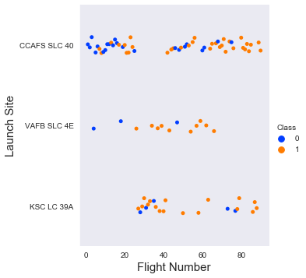
Launch Site VS. FLIGHT NUMBER
The scatter plot of Launch Site vs. Flight Number shows that:
As the number of flights increases, the rate of success at a launch site increases.
Most of the early flights (flight numbers < 30) were launched from CCAFS SLC 40, and were generally unsuccessful.
The flights from VAFB SLC 4E also show this trend, that earlier flights were less successful.
No early flights were launched from KSC LC 39A, so the launches from this site are more successful.
Above a flight number of around 30, there are significantly more successful landings (Class = 1).

Slide 19

Section 2

Slide 20
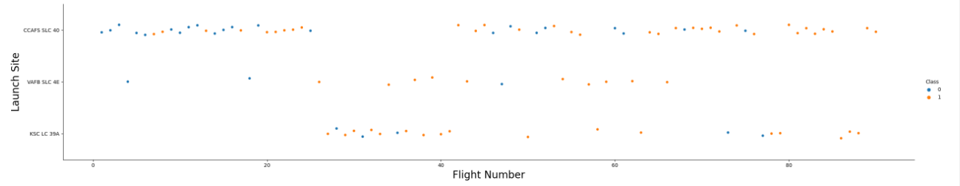
Flight Number vs. Launch Site
The scatter plot of Launch Site vs. Flight Number shows that:
Increase in flight increases the Success rate.
The flights from VAFB SLC 4E also show this trend, that earlier flights were less successful.
Above a flight number of around 30, there are significantly more successful landings (Class = 1).

Slide 21
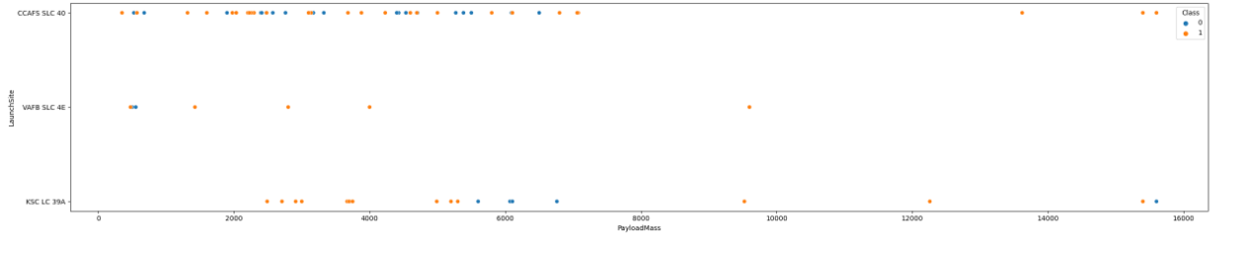
Payload vs. Launch Site
Results of Payload vs Launch site as as follows
Above a payload mass of around 10000 kg there are very few unsuccessful landings, but there are few launches with this payload
All sites launched a variety of payload masses, with most of the launches from CCAFS SLC 40 being comparatively lighter payloads with few exceptions.

Slide 22
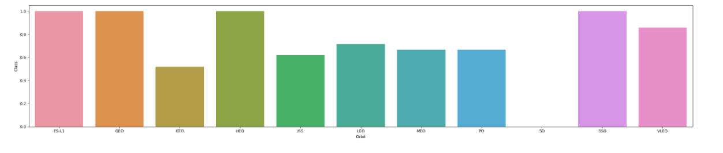
Success Rate vs. Orbit Type
Success rate for ES-11, GEO, HEO and SSO is 100%
SO has no success.

Slide 23
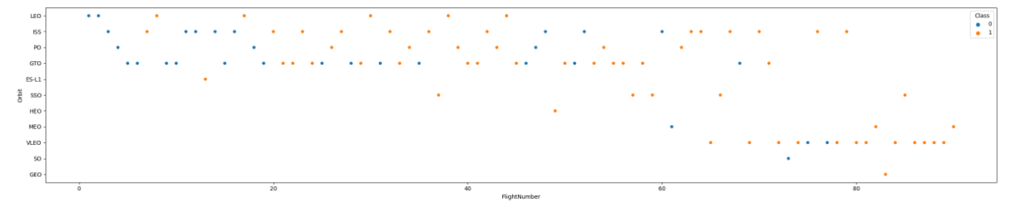
Flight Number vs. Orbit Type
SSO has 5 flight with 100% success where as GEO, HEO, and ES-L1 orbits have only 1 flight, we need more data to ascertain their success.
Increase in flight’s increases the probability of success

Slide 24
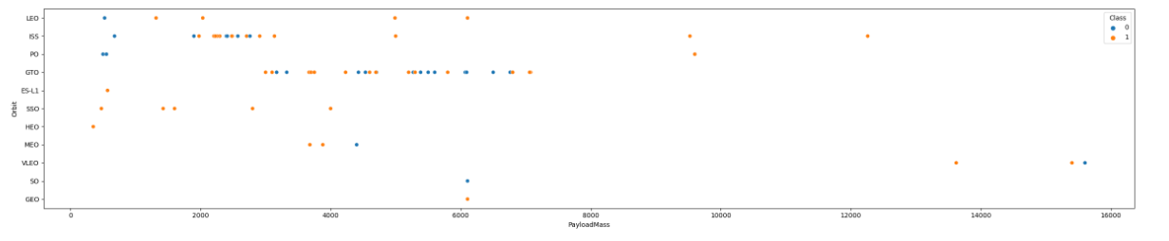
Payload vs. Orbit Type
VLEO – Heavier payload
PO,ISS and LEO has more success rate as per the available data

Slide 25
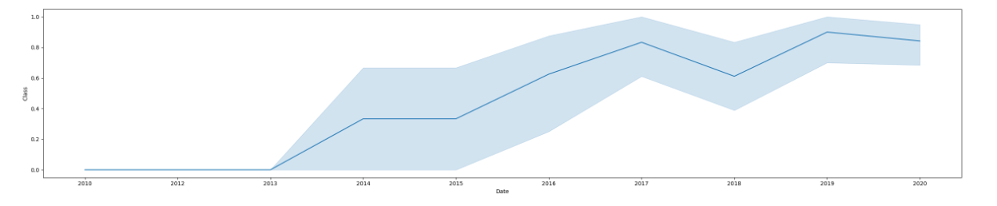
Launch Success Yearly Trend
2010 to 2013 no success
From 2013 the success rate has increased progressively
From 2019 the success rate is considerably high reaching to its peak

Slide 26
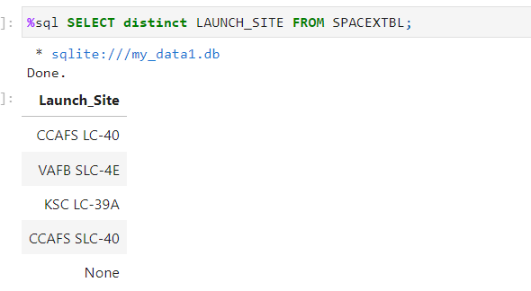
All Launch Site Names
Distinct clause gives the Unique values in the given column(s)

Slide 27
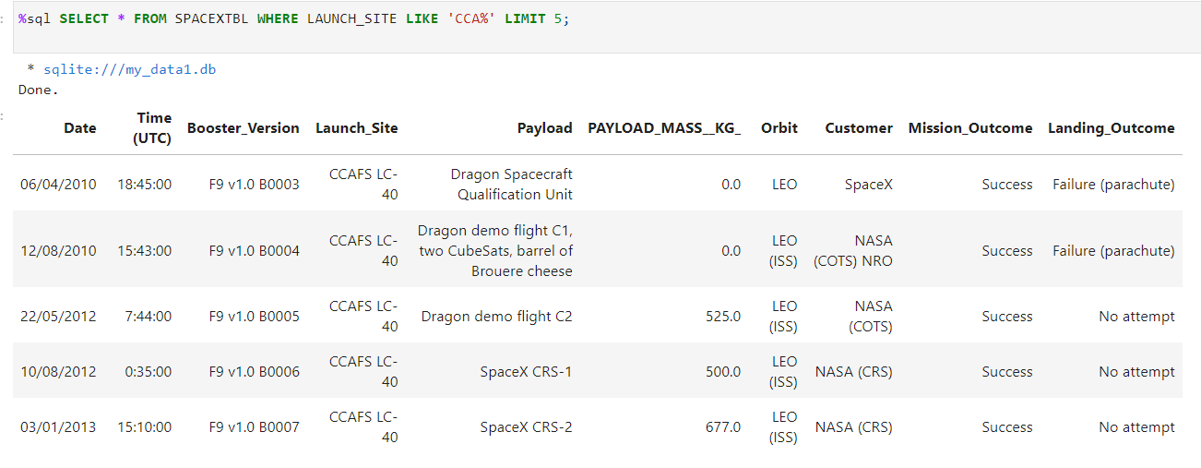
Launch Site Names Begin with 'CCA'
* is a wild card characters representing multiple characters ;
Limit 5 – Gives only 5 rows

Slide 28
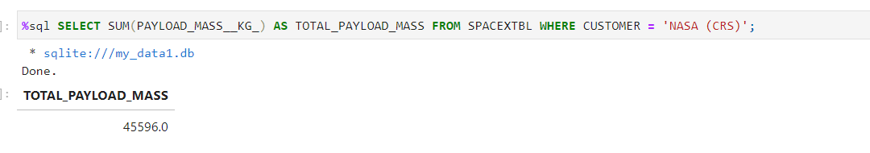
Total Payload Mass
Sum function adds all the column values given , the rows are filtered by the where clause

Slide 29
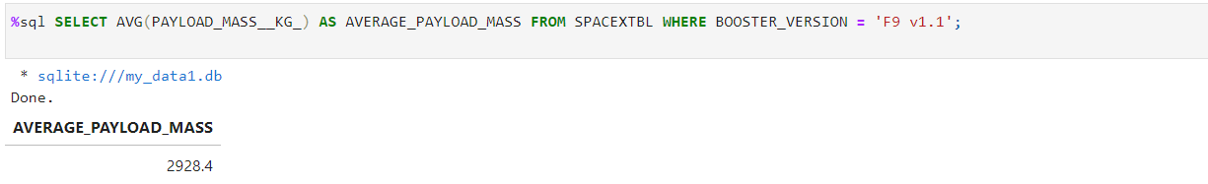
Average Payload Mass by F9 v1.1
Avg function finds the average of the given data
Where clause filters the record based on the given condition ; here it is for Booster_Version=‘F9 v1.1’

Slide 30
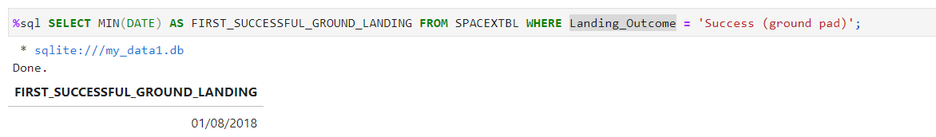
First Successful Ground Landing Date
Min function finds the earliest (in case of date) or the least lesser value (in case of numbers)

Slide 31
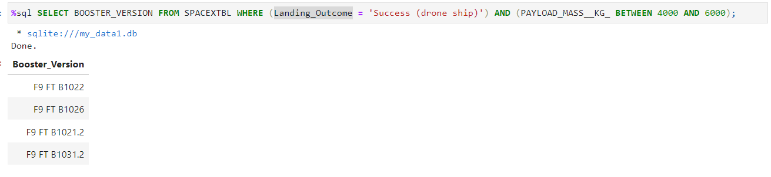
Successful Drone Ship Landing with Payload between 4000 and 6000
Between clause searches for values between a given Range

Slide 32
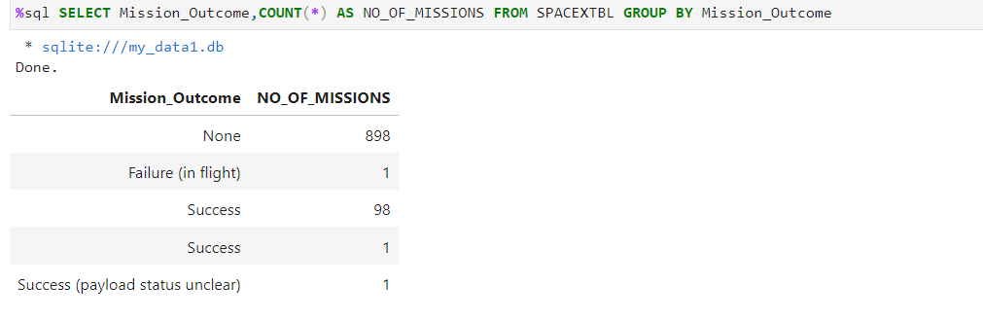
Total Number of Successful and Failure Mission Outcomes
Group by clause Groups the data as per the given column name, Count(*) – Counts the number of Rows

Slide 33
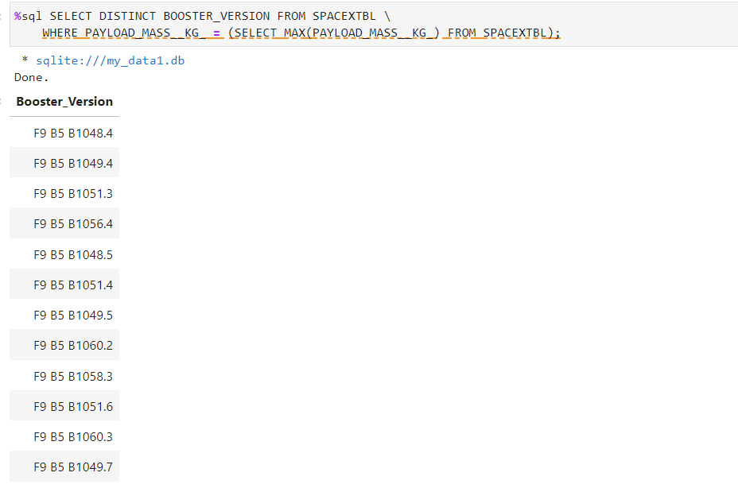
Boosters Carried Maximum Payload
Maximum finds the highest value in the given query; the Subquery gives the value that can be used by the main query to filter data

Slide 34
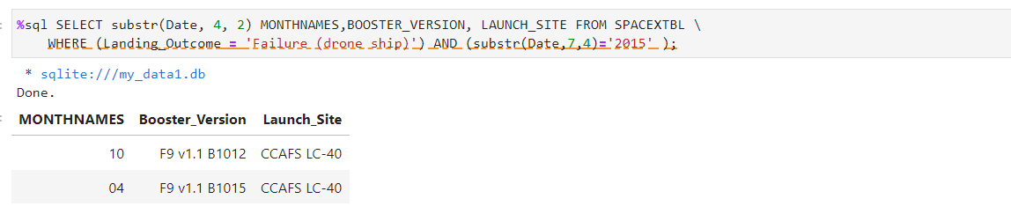
2015 Launch Records
Substring function is used to extract part of a string or date.
And clauses is used to combine multiple conditions. If both are true then the rows that match both the condition are shown

Slide 35
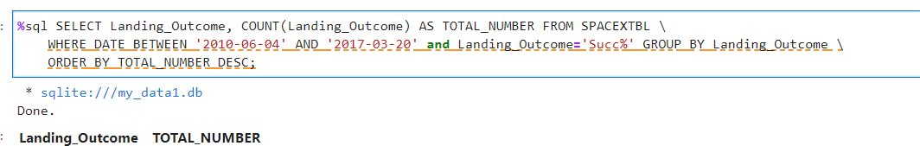
Rank Landing Outcomes Between 2010-06-04 and 2017-03-20
Order by clauses sorts the data by the given column(s) . Desc clause with the Order by sorts the data in descending order

Slide 36

Section 3

Slide 37




All Launch Sites Location
All Launch Sites

Slide 38






SUCCESS/FAILED LAUNCHES FOR EACH SITE
Clusers used to group Launches,
Green icons – Success
Red icons - Failure.
CCAFS SLC-40 and CCAFS LC-40
VAFB SLC-4E
KSC LC-39A
$$=$$

Slide 39
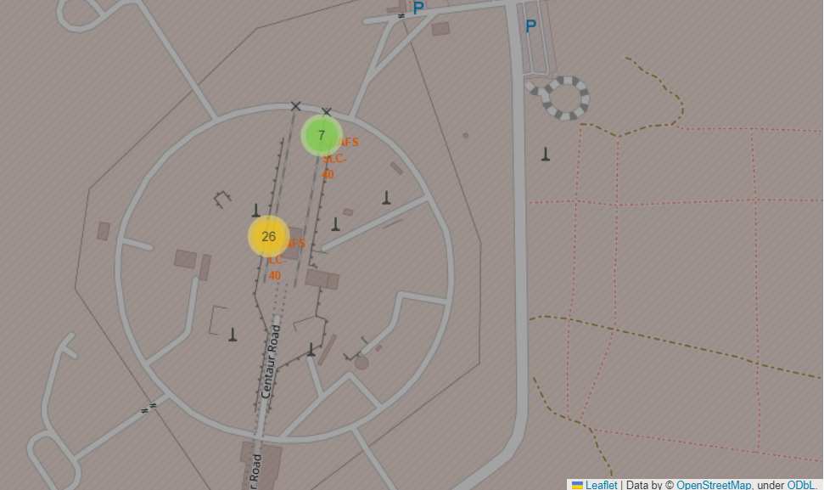
Proximity of the Launch site the Roads
It is Near to the Road

Slide 40

Section 4

Slide 41

Launch Success Ratio
KSC LC-39 A is the most successful with 41.7% Successes

Slide 42


Pie chart – with Success Rate of KSC LC-391
The launch site KSC LC-39 A also had the highest rate of successful launches, with a 76.9% success rate.
Note: $class\left\{\begin{aligned}0, Failure \\ 1, Success\end{aligned}\right.$

Slide 43


Launch Outcome VS. Payload scatter plot for all sites
Payloads are of different types Low, Medium to Huge
Note: c$lass\left\{\begin{aligned}0, Failure \\ 1, Success\end{aligned}\right.$

Slide 44

Section 5

Slide 45
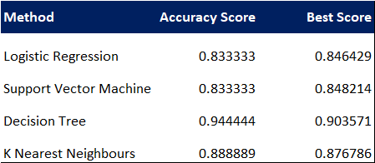
Classification Accuracy
Decision Tree is given the best – Accuracy and Score

Slide 46
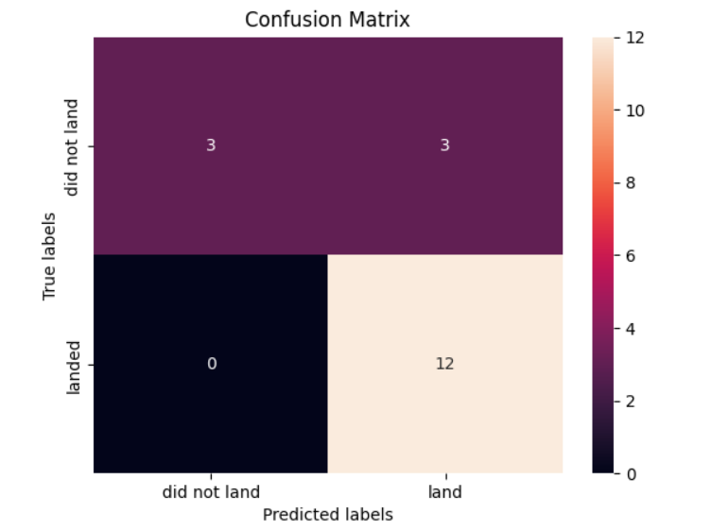
Confusion Matrix
The Big number of True positive(12) gives the high accuracy level.

Slide 47
Conclusions
There is a gradual progression of Launch success, from 2019. It shows that there has been a good learnings from the earlier failures
The Launch site KSC LC-39 A is the most successful with 41.7% success rate
Success rate for ES-11, GEO, HEO and SSO (with 5 launches) is 100%
Decision Tree classification gives the highest accuracy and Best Score.

Slide 48
Appendix
Resources:
Python For Beginners | Python.org
Machine learning, explained | MIT Sloan

Slide 49
Exploratory Data Analysis Results
Success rate is increasing with increase in number of flights launched
Above 7000kg the success rate decreases
100% success rate for ES-L1,GEO,HEO and SSO; Lowest rate is SO
Success started from 2013 and has been progressively increasing
Average payload for Falcon 9 v1.1 booster is 2,928kg
Success rate of Falcon 9 was better in landing on Drone ships with above the average payload

Slide 50


